Slide 1
Web Development
Domain Introduction
by Prathamesh Shiralkar (23254)
Notes:
Next: slide 13
‹#›

Slide 2
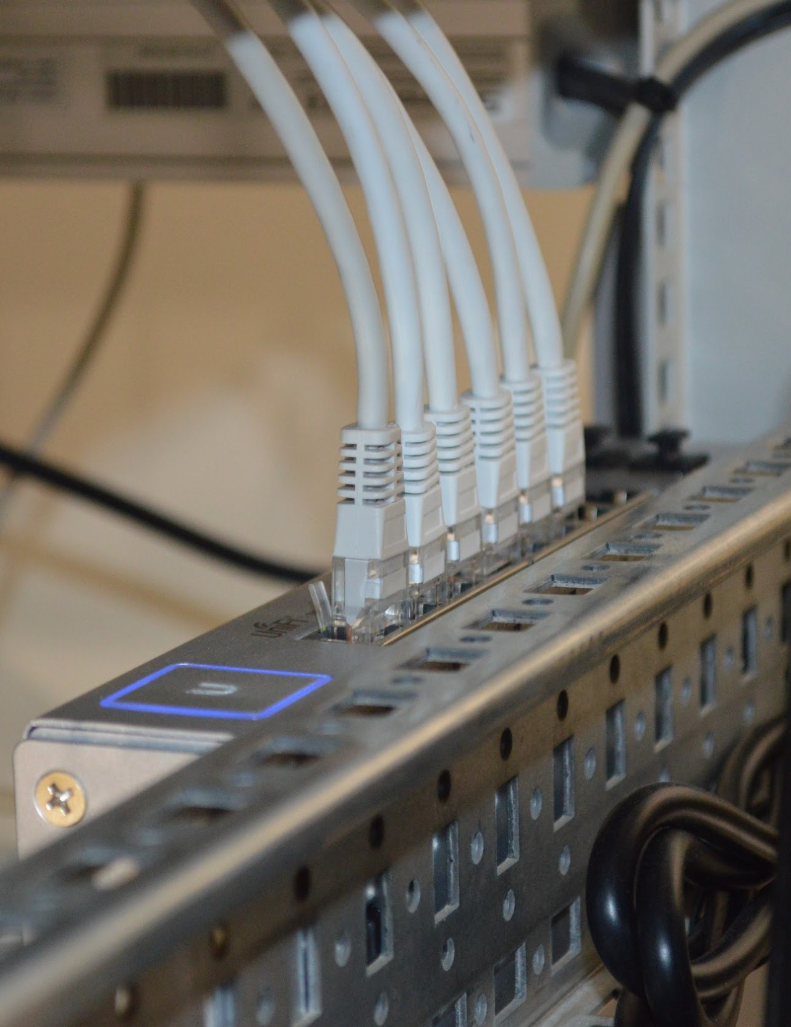
Motivation
Internet and web development play a very important role in digitalization.
So, as a Computer Engineers, we should be aware of how the web works.
JOHN DOE
CEO

Slide 3
Introduction
Web Development is basically developing a website.
This includes all aspects such as website design, databases, etc.
But, web these days is not only limited to this.

Slide 4


Web Basics
What is Website?
Collection of Web Pages. First page of any website is
called home ge for that site.
What is Web Server?
A Place from where the website is hosted..
Each web server is given a unique address known as
IP Address. eg. for google.com it’s 172.217.160.206
What is Web Browser?
To access the Web you need a web browsers, such
as Chrome Microsoft Edge or Mozilla Firefox.

Slide 5
What Happens when you type google.com in search bar?
Notes:
‹#›

Slide 6
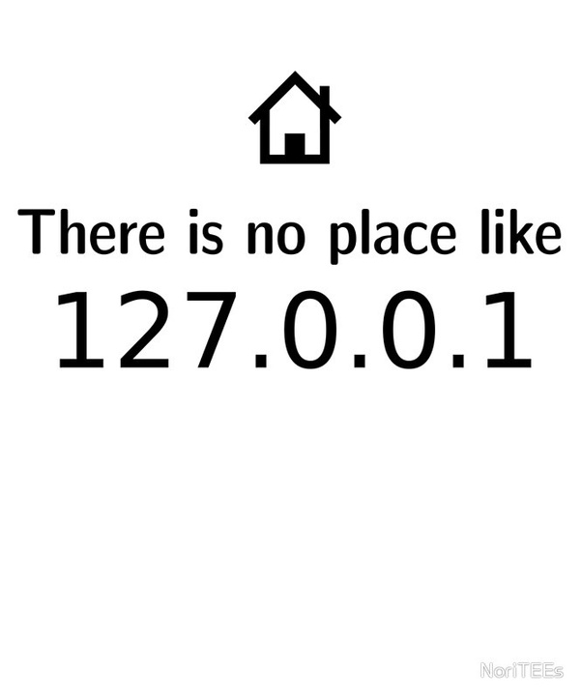
Computer and other devices communicate using ip addresses to identify each other on the internet.
209.85.129.103
192.228.29.1
74.125.77.106
147.67.119.102
142.236.154.112
92.123.122.103
193.252.122.103

Slide 7
People Don’t Remember IP Addresses So They Use Words
www.google.com
www.acm.org
www.pict.acm.org
www.pictoreal.in
www.pict.edu
www.prevue.tech
www.qwerty.com
localhost

Slide 8
The Domain Name System Brings in the two together and gets you to your destination
209.85.129.103
192.228.29.1
74.125.77.106
147.67.119.102
142.236.154.112
92.123.122.103
193.252.122.103
www.google.com
www.acm.org
www.pict.acm.org
www.pictoreal.in
www.pict.edu
www.prevue.tech
www.qwerty.com

Slide 9
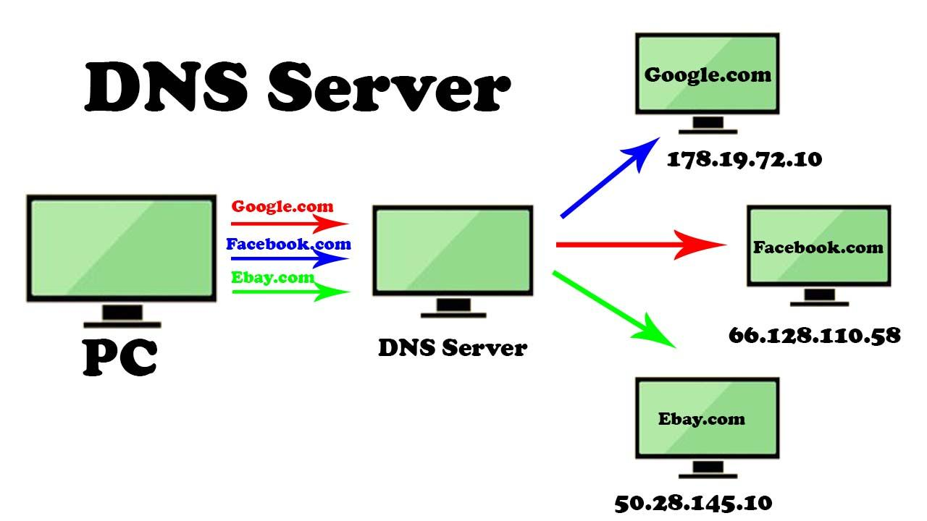

Slide 10
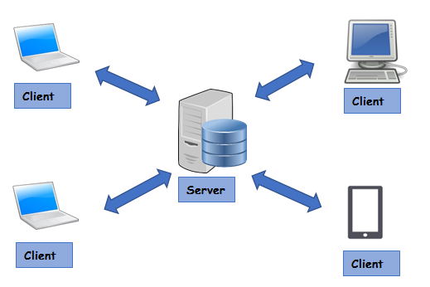
The client-server Architecture
Server -
Server is a computer which hosts or serves the website.
It has all the data of the website.
Client
Clients are the devices which connect to
the server , i.e. visit the website.
Client can be any device like PC, laptop,
mobile, etc

Slide 11
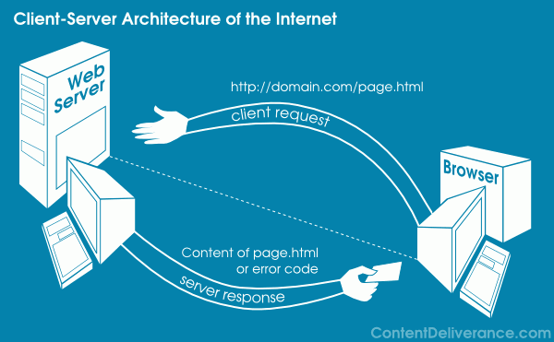
The client-server Architecture
What exactly happens when you
access a website?
Your browser sends a request to the website
server, e.g. http://domain.com/page.html.
Server processes the request, i.e. reads the
requested webpage (page.html here).
Now, server sends this page as a response
to the client.
If something goes wrong, server sends the respective error.
Your browser reads the response and renders the page sent by server, which you see on the screen.

Slide 12
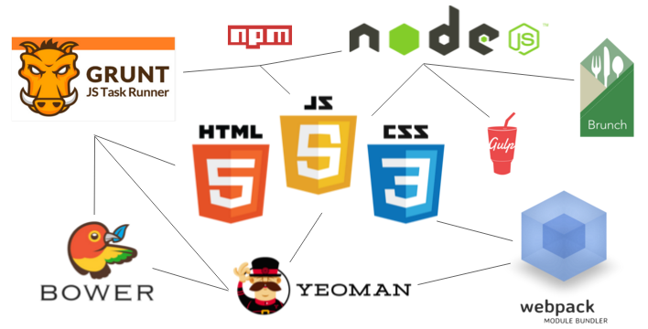
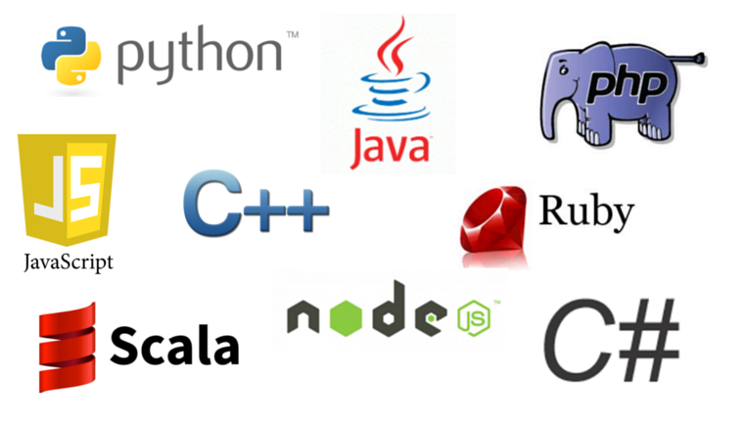

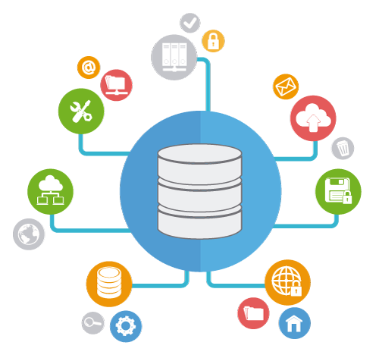
Web Development
Frontend Dev.
Backend Dev.
Database

Slide 13







Frontend
The front-end is everything involved with what the user sees and interacts with. It includes graphical design, aesthetics, interaction with user.
HTML - Basic markup language for webpages
CSS - Adds styles to basic webpages
Javascript - Adds logic and interaction to webpage

Slide 14





Backend
The back-end is server-side development.
It is the term used for the behind-the-scenes activities, i.e. the data processing and the logic performed to respond with the appropriate information as requested by the user.
Performs actions like logging in a user, display information from database, etc

Slide 15




Database
Database is a systematic collection of data. Databases support storage and manipulation of data and makes data management easy.

Slide 16


That’s not all!
These days, web development is a lot more than just the websites! Using Javascript frameworks like electronJS, React native, etc you can even develop Desktop, Android and iOS apps just using HTML, CSS and JS!

Slide 17
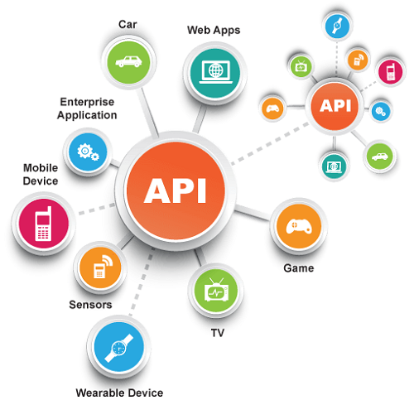
That’s not all!
Also, APIs have become very popular these days. Basically, API stands for Application Programming Interface. It is a website which returns the machine understandable data in formats like JSON, XML, etc.

Slide 18

Conclusion
We understood the coding and engineering side of the internet and various web technologies.
Web these days is not only limited to websites, but also includes desktop/app development
and API development.
JOHN DOE
CEO

Slide 19
References
Images - Google Images
Info - Quora, Medium.com, Google
Learn web development - w3Schools, YouTube.

Slide 20
Thank You!
Any Questions?
By -
Prathamesh Shiralkar (23254)
(www.github.com/pnshiralkar)

